Slide 1

Machine Learning Techniques to Predict Image Captions
Arjun Pesaru, Hiranmai Devarasetty

Slide 2

What is the problem?
Bridging the gap between visual content and textual descriptions.
Automating the process of generating accurate and meaningful captions for images.
Improving accessibility for visually impaired individuals.
Enhancing content indexing and searchability in large image databases.

Slide 3
Dataset Overview
Dataset: (Image + Text) Flickr 8K dataset
Size: 8,000 images
Captions: 5 captions per image (40,000 total captions)
Image Format: JPEG
Caption Format: Text files
Source: Kaggle (https://www.kaggle.com/datasets/adityajn105/flickr8k)

Slide 4

Why This Problem Matters
Significance of the Problem:
Enhances accessibility for visually impaired users, allowing them to understand image content.
Improves Image searchability and organization in large databases.
Enables more efficient content moderation on social media platforms.
Advances the field of AI by combining Computer Vision and Natural Language Processing.
Potential applications in various industries like e-commerce, journalism, and education

Slide 5

Proposed Approaches
Image Feature Extraction:
Use pre-trained CNN (e.g., ResNet50, InceptionV3) to extract image features
Fine-tune the CNN on Flickr8k dataset
Text Processing:
Tokenize captions
Create vocabulary from all captions
Implement word embeddings (e.g., Word2Vec, GloVe)
Caption Generation Model:
Encoder-Decoder architecture with attention mechanism
LSTM or GRU for sequence generation
Implement beam search for caption prediction.

Slide 6
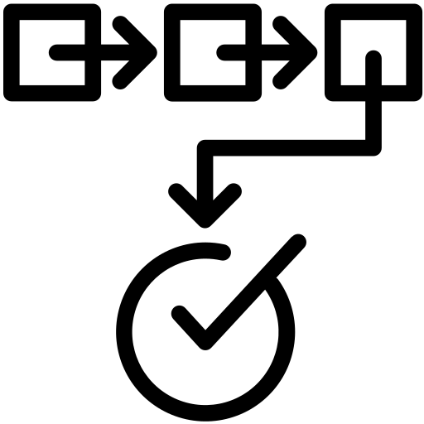
Rationale for Approach
Why These Approaches?
CNNs: Proven effectiveness in image feature extraction and classification.
RNNs: Capable of handling sequential data, ideal for generating coherent sentences.
Transformers: State-of-the-art performance in various NLP tasks, including caption generation.
Integration: Combining these approaches allows for a robust model that can understand visual content and generate relevant textual descriptions.

Slide 7
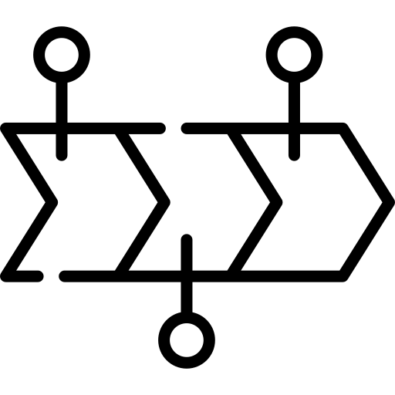







Timeline
- Build the caption generation model using an Encoder-Decoder architecture - Implement LSTM or GRU for sequence generation
- Evaluate model performance using metrics like BLEU, METEOR, CIDEr - Finalize the model and prepare for deployment
- Implement image feature extraction using a pre-trained CNN (e.g., ResNet50) - Start initial experiments with feature extraction and visualization
Oct 28 - Nov 3
Nov 11 - Nov 17
Nov 25 - Dec 1
Nov 4 - Nov 10
Nov 18 - Nov 24
Dec 2 –
Dec 6
- Dataset exploration and preprocessing - Familiarize with the Flickr8k dataset and its structure - Set up the development environment (libraries, tools)
- Develop text processing pipeline for captions - Tokenization and vocabulary creation - Implement word embeddings (e.g., GloVe or Word2Vec)
- Integrate attention mechanism into the model - Train the model on the Flickr8k dataset - Monitor training performance and adjust hyperparameters

Slide 8

Work Division
Arjun Pesaru:
Focuses on the model development and image processing.
Implements ML Techniques for feature extractions.
Conducts performance evaluation for captions accuracy.
Hiranmai Devarasetty:
Leads the environment setup and text processing pipeline.
Prepares data with tokenizations and word embeddings.
Implements attention mechanism within the model.

Slide 9

Expected Outcomes & Deliverables
Expected Outcomes:
A robust image captioning model that generates accurate and contextually relevant descriptions.
Insights into the effectiveness of different Machine Learning architectures for this task.
Deliverables:
Trained image captioning model.
Comprehensive project report detailing methodology, results, and analysis.
GitHub repository with documented code.

Slide 10
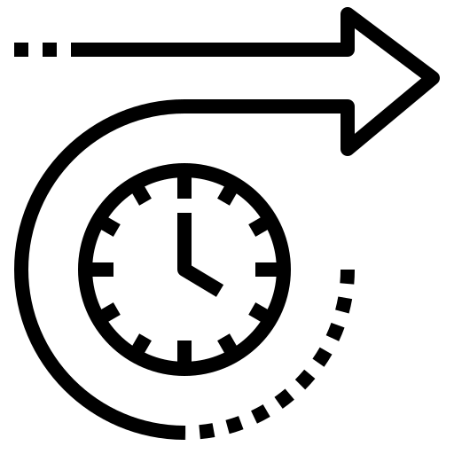
Conclusion
Recap Key Points:
Addressing the challenge of automated image captioning has significant implications for accessibility and content management.
The project combines cutting-edge techniques in Machine Learning, Computer Vision and NLP.
Potential for real-world impact in various industries.
Enthusiasm for the Project:
Excited to contribute to the field of AI and potentially improve accessibility for visually impaired individuals.
Looking forward to overcoming challenges and pushing the boundaries of image understanding.
In the future, this model could enable image retrieval by description within the large datasets, allowing users to find images through natural language input.

